Slide 1
Magic vs Science
Telerik Next’s {N} Workshop
Sebastian Witalec

Slide 2

More Science Than Magic

Slide 3
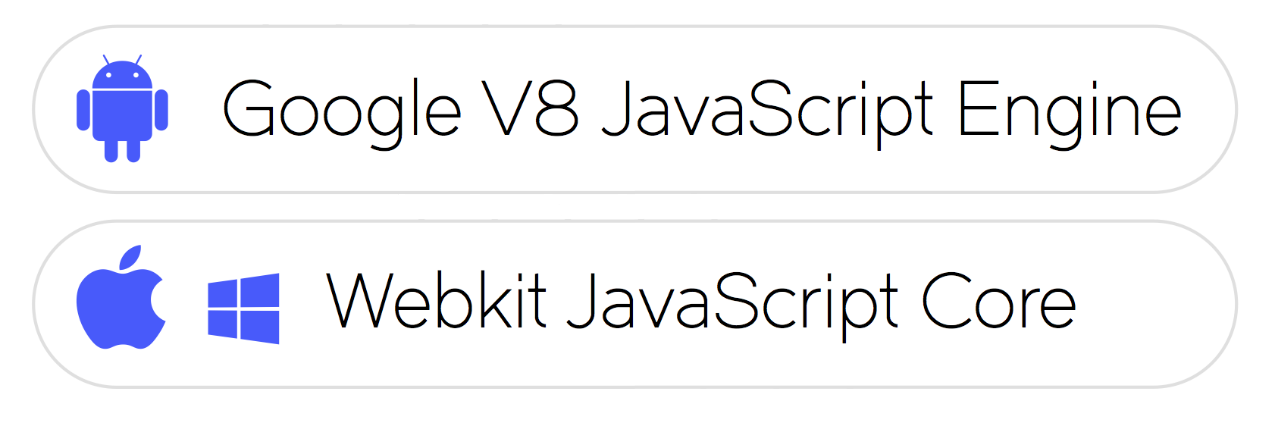
JavaScript Virtual Machine
Notes:
This is going to be like trying to explain a magic trick, so I hope it won’t take the magic out of it.
NativeScript is not just a set of libraries, but more of a Runtime that enables you to call native APIs: for Android, iOS and Windows Universal
It uses a pre-packaged JavaScript Virtual Machine. To be precise:
•For Android it is – Google’s v8 JavaScript Engine,
•For iOS and Windows Phone it is – WebKit’s JavaScriptCore

Slide 4
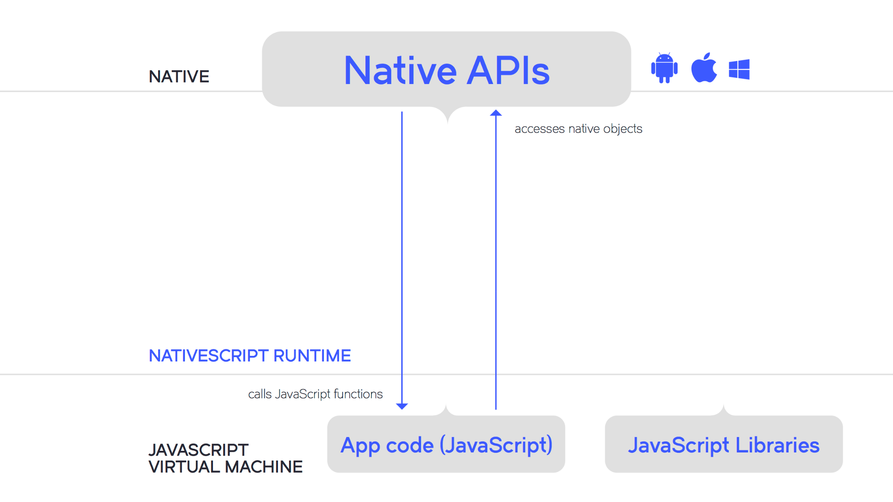
Notes:
(1)The JS Virtual Machine interprets and executes the JavaScript code.
(2) All calls to the Native API are delegated to the <click> Metadata
It is made of several major parts:
A JavaScript Virtual Machine – to interpret and execute the JavaScript code. Then we have:
<Before the next slide>
A Bridge

Slide 5
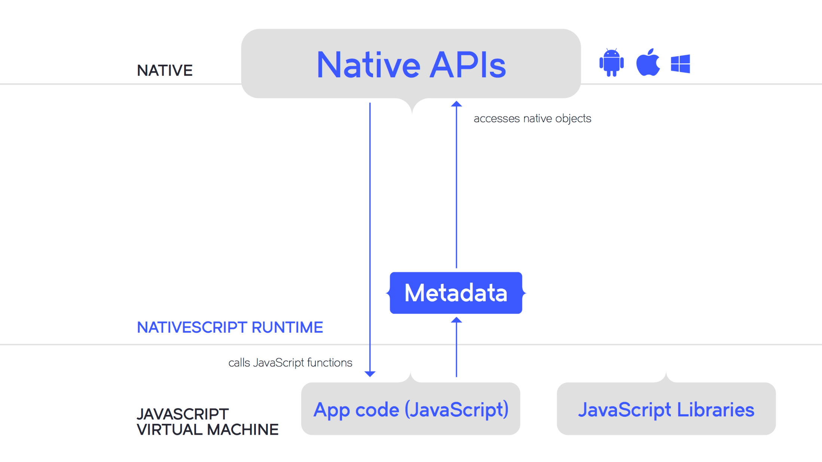
Notes:
(2) All calls to the Native API are delegated to the
<…> Metadata - a pre-built set of all available APIs on each platform – the Metadata is used to lookup each method/type signature.
Then the

Slide 6
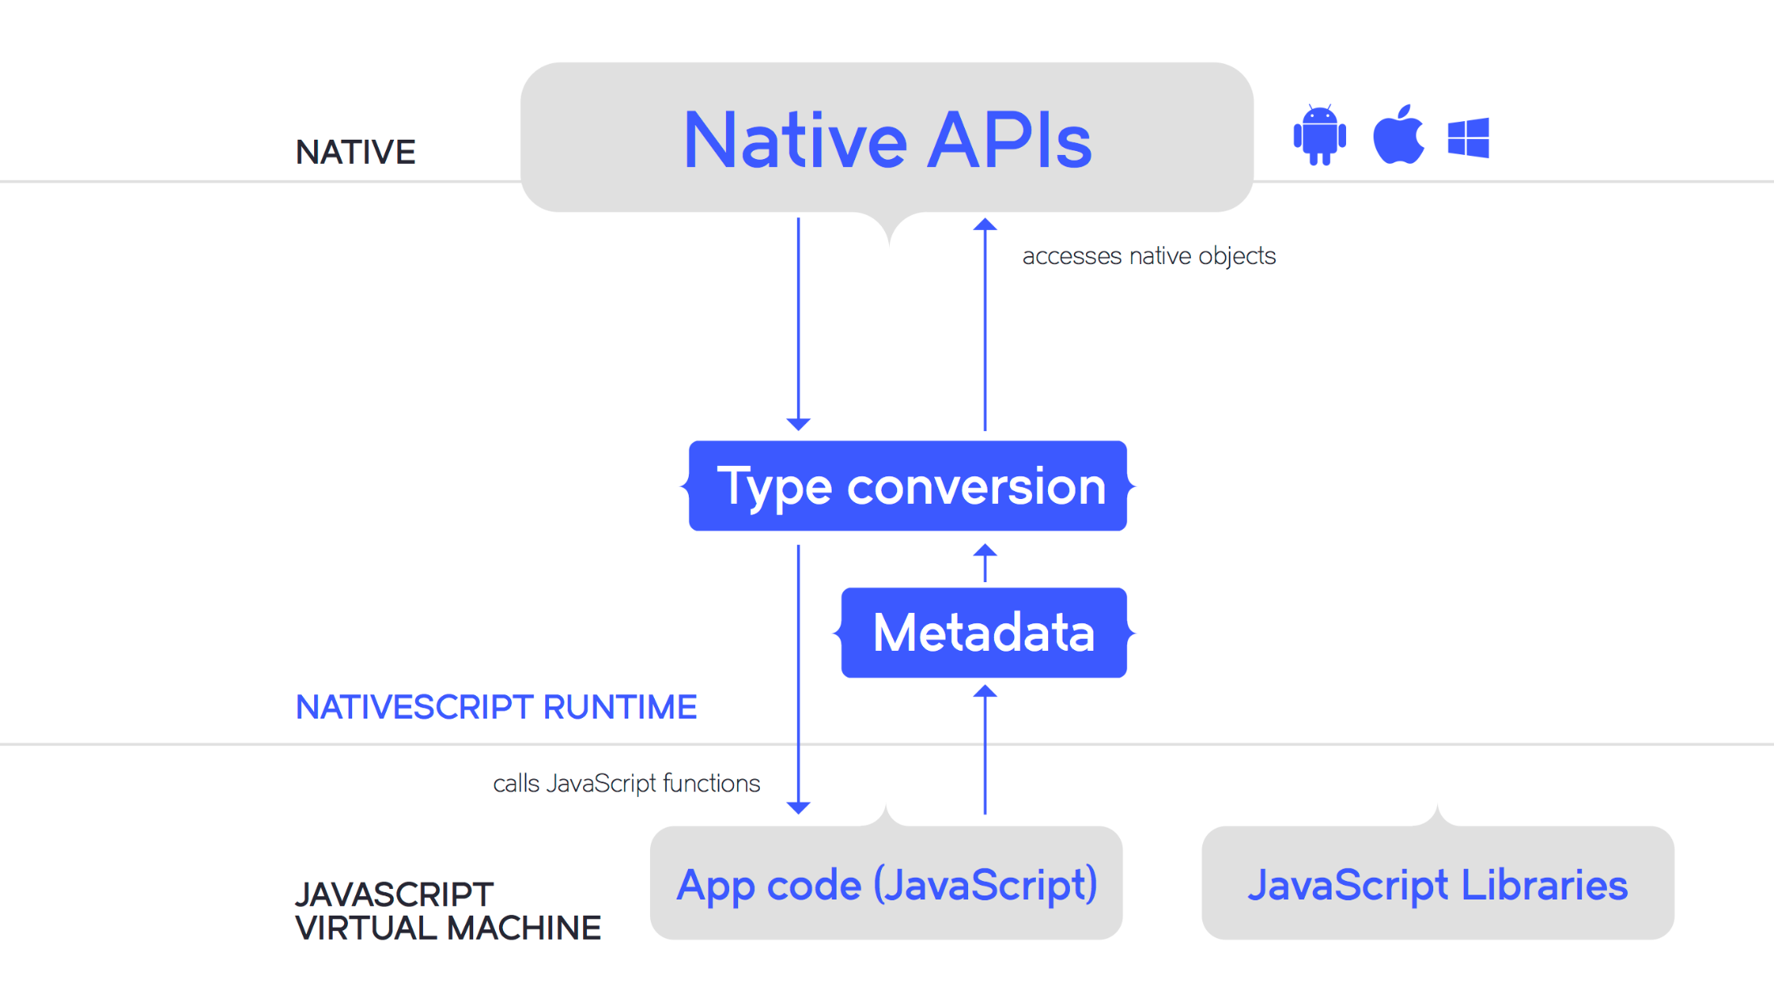
Notes:
(3) The Type Conversion Module: handles data transfer from JavaScript to Native types and in reverse from Native to JavaScript types.
The finally…

Slide 7
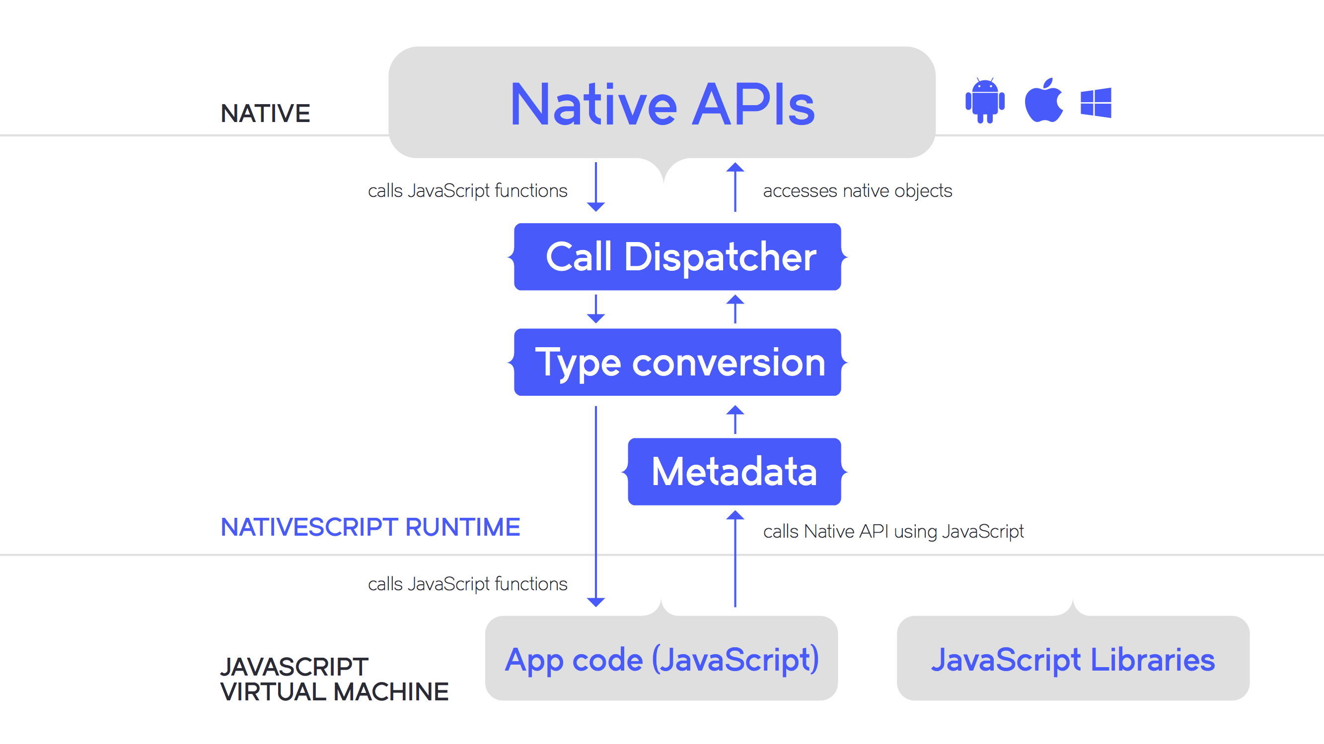
Notes:
(4) The Call Dispatcher makes an actual call to the Native API and takes care of passing down the results.
All of this means that you can access any function and any type available in each platforms API.
<Before the next slide>
To visualise it let’s have a look at a piece of JavaScript code

Slide 8


Slide 9
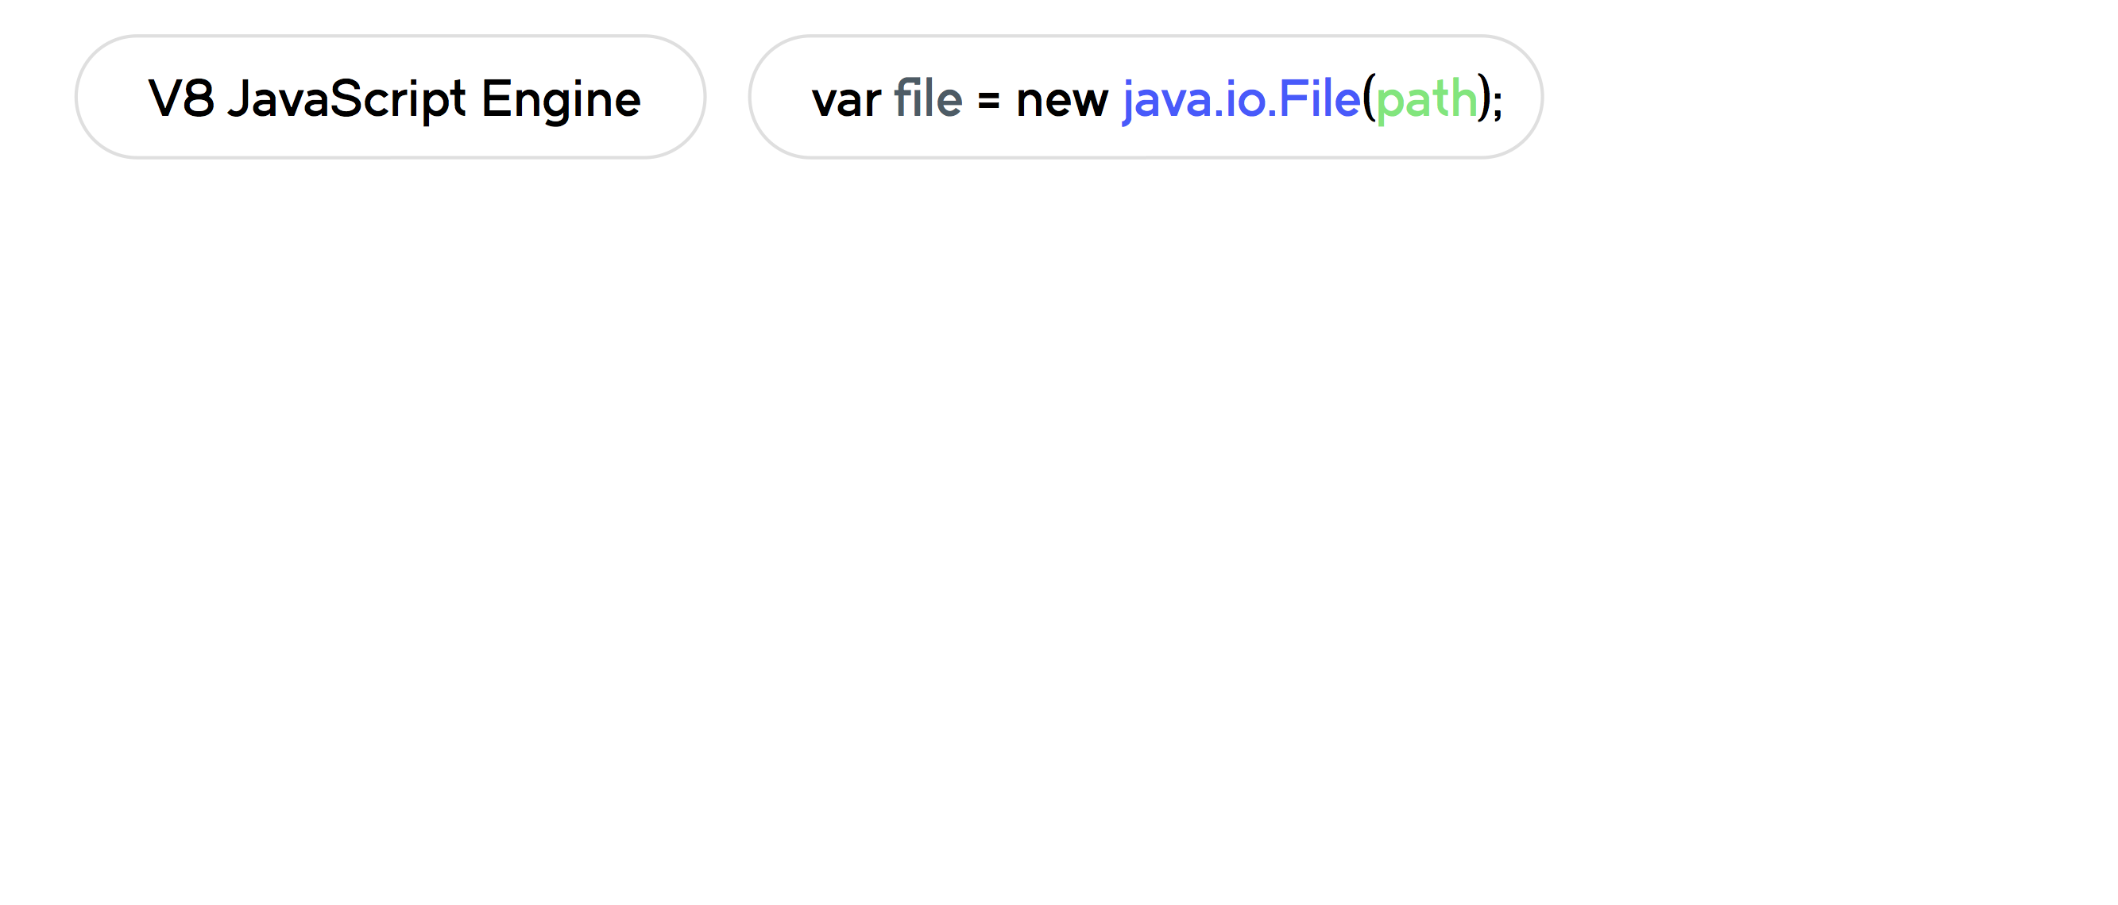
Calling Android API
Notes:
var file = new java.io.File(path);
which calls Android API to create a file object.
The JavaScript Virtual Machine or in this case Google’s v8 JavaScript Engine, evaluates the code.

Slide 10
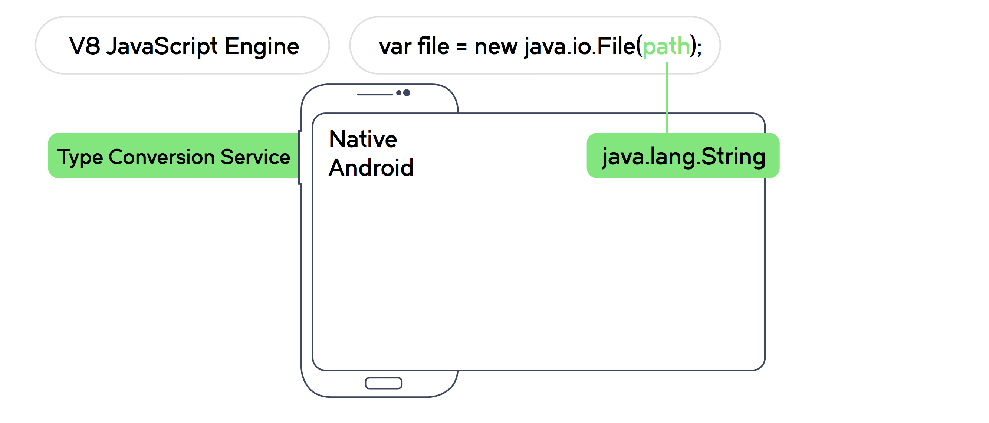
Calling Android API
Notes:
The Type Conversion Service converts the path value, from the JavaScript String to the native Java String object.

Slide 11
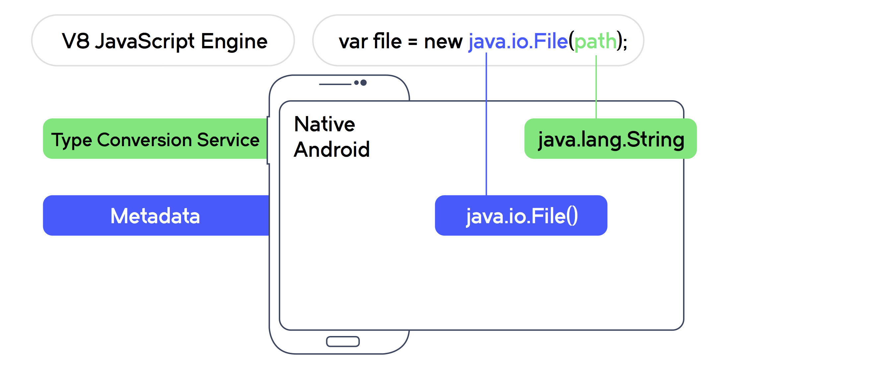
Calling Android API
Notes:
Metadata will lookup the Android API and determine the corresponding native method to call
and as a result finding the native constructor for the File class.

Slide 12
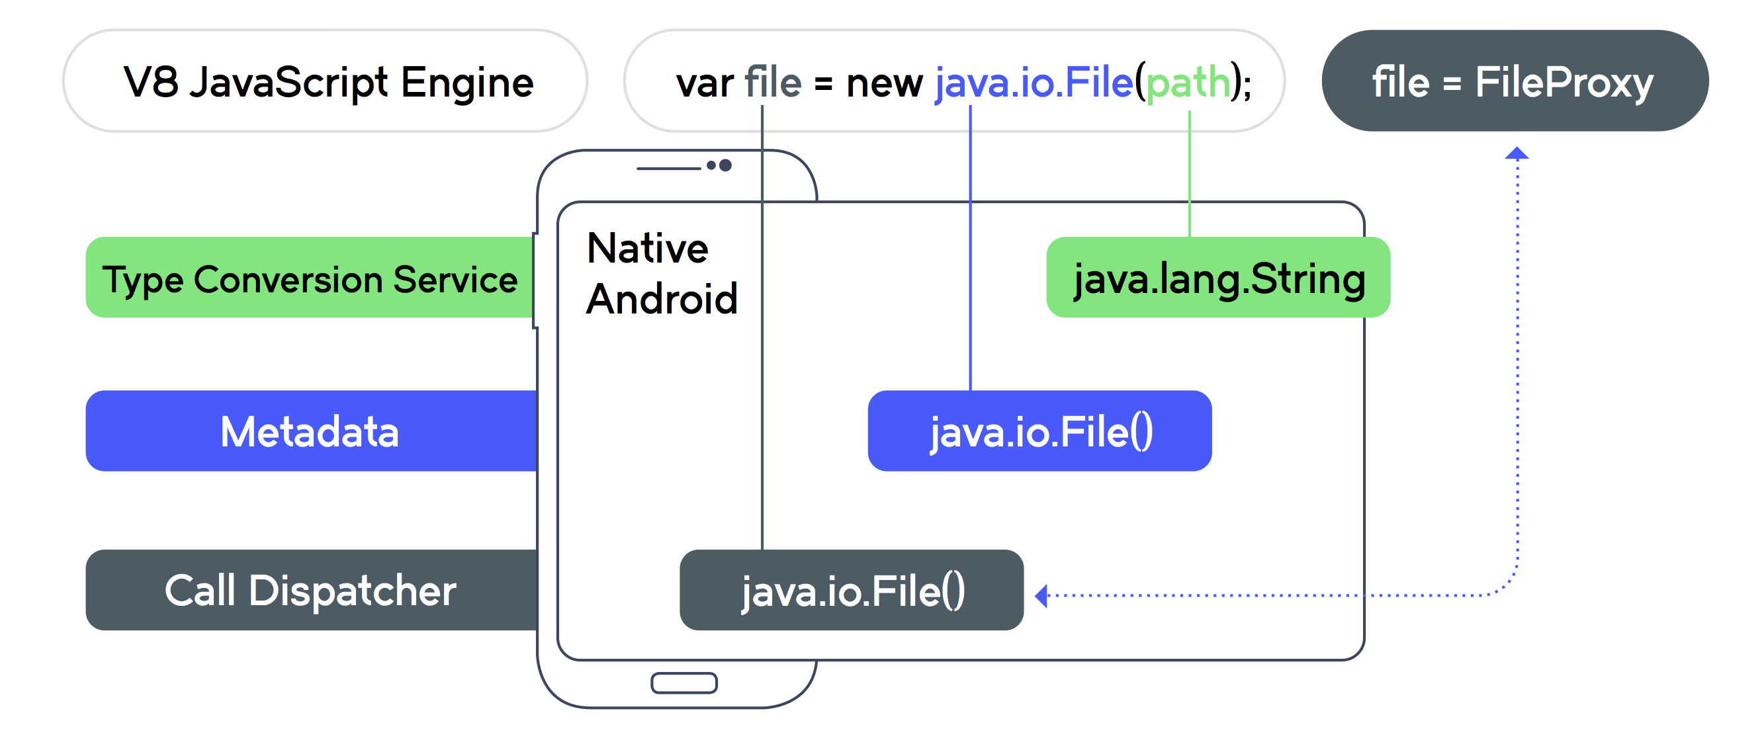
Calling Android API
Notes:
The call dispatcher executes the call with a dual result:
•On the Android Side: we get a new instance of the native File class
•On the NativeScript Side: we get a custom JavaScript Object serving as a proxy to the native Android’s object
When a method is called on this proxy it is delegated to the underlying native object.
<Before the next slide>
This is the foundation of the NativeScript framework.
The next logical step was to create a platform agnostic abstraction layer.
It is really great that you can access native APIs straight form JavaScript.
But I can hear you think. … this still doesn’t solve the problem of me having to learn all those Platform APIs.
But this is just the foundation of the NativeScript framework.

Slide 13
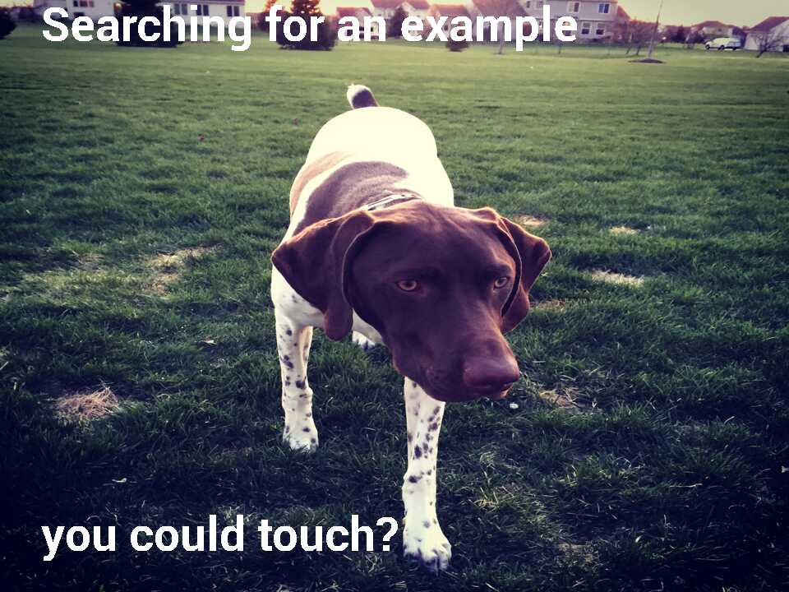

Slide 14
image-manipulation module
image-manipulation.android.js
var paint = new android.graphics.Paint();
paint.setTypeface(type);
paint.setTextSize(fontSize);
image-manipulation.ios.js
var topRect = CGRectMake(30, 30, image.size.width, image.size.height);
var topString = NSString.alloc().initWithString(topText);
topString.drawInRectWithFont(topRect, font);

Slide 15

This my dear is What modules are made of

Slide 16
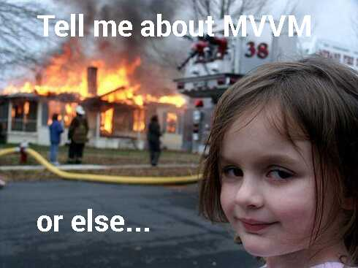

Slide 17

Model

Slide 18

View

Slide 19

ViewModel

Slide 20

Model
DATA

Slide 21


Model

Slide 22

View
UI

Slide 23
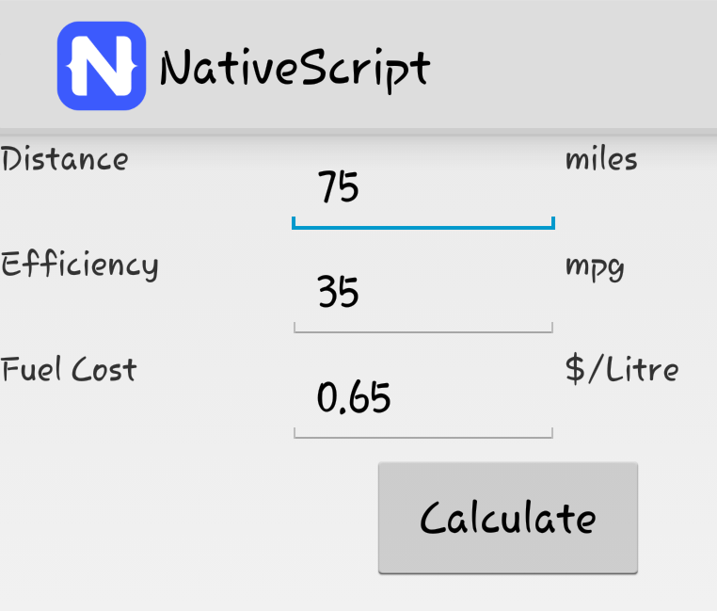
View
<Page navigatedTo="loadCalculatorView">
<StackLayout>
<Label text="Distance" width="100"/>
<TextField text="{{distance}}" width="100"/>
<Label text="miles" />
<Label text="Efficiency" width="100" />
<TextField text="{{efficiency}}" width="100"/>
<Label text="mpg" />
{…}
<Button tap="calculate" text="Calculate" width="100"/>
</StackLayout>
</Page>

Slide 24




View ViewModel Model
Connects
Application Logic

Slide 25
Bindings
View: XML
Property Bindings:
<Label text="{{currentCard}}" />
Expression Bindings
<Label text="{{score + ' ('+ streak +') '}}" />
Action Bindins
<Button text="Lower" tap="{{ goLower }}"/>
ViewModel: JavaScript
var viewModel = new observable.Observable();
viewModel.set("{{currentCard}}", "5");
viewModel.set("{{streak}}", "0");
viewModel.goLower = function() {
//Do go lower here
}

Slide 26

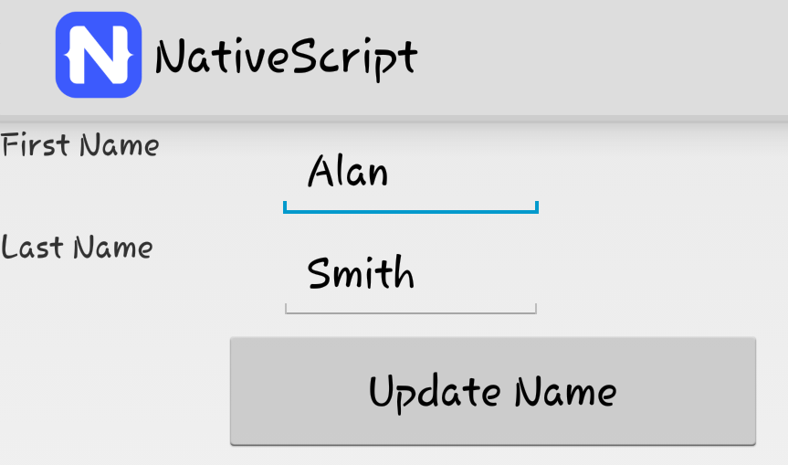
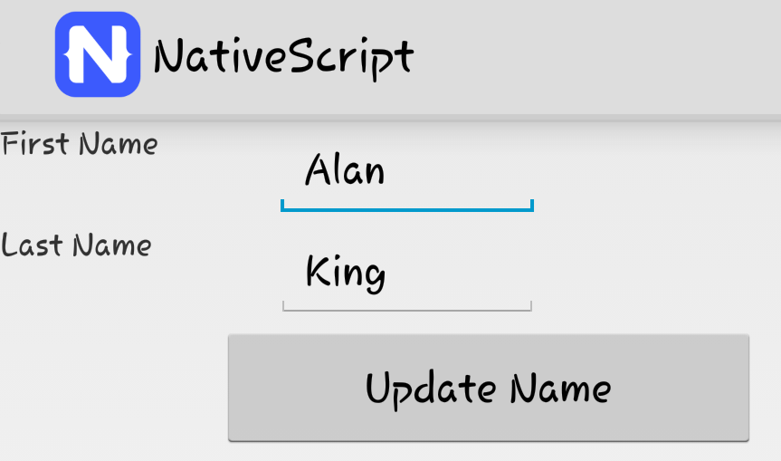
To set or not to set
viewModel.updateName() {
this.firstName = "Jack";
//vs
this.set("lastName", "King");
}

Slide 27

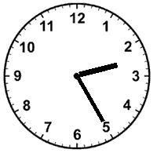

Demo Time
N

Slide 28


Understanding users
Magic Science
OR

Slide 29
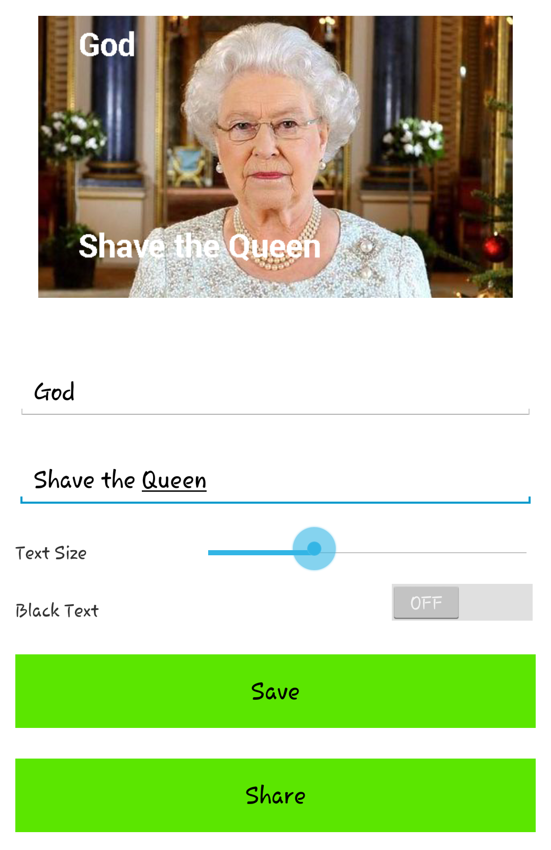
How much would you give to know?
?

Slide 30
Setup
var NativeScriptMonitor = require('./NativeScriptMonitor').Monitor;
var monitor = new NativeScriptMonitor({
productId: ‘e4680536-g543-8gjd-bs98-0dj4dj-2hd467',
version: '1.2.3'
});

Slide 31
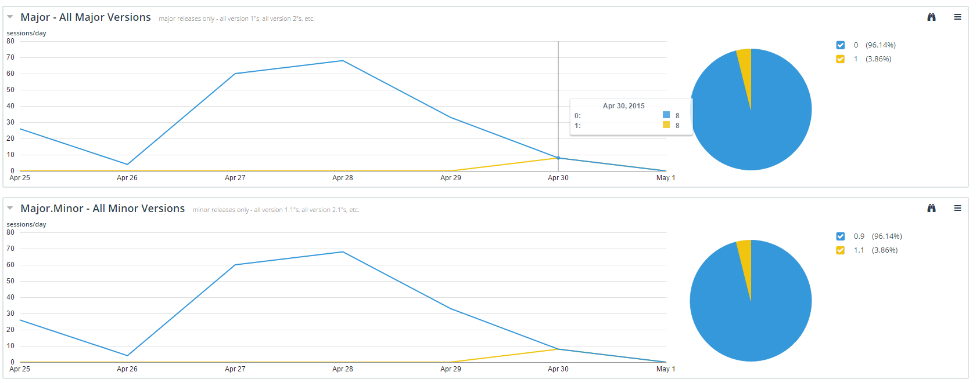
Versions

Slide 32
Manage Session
When Application starts
monitor.start();
Before App Closes
monitor.stop();

Slide 33
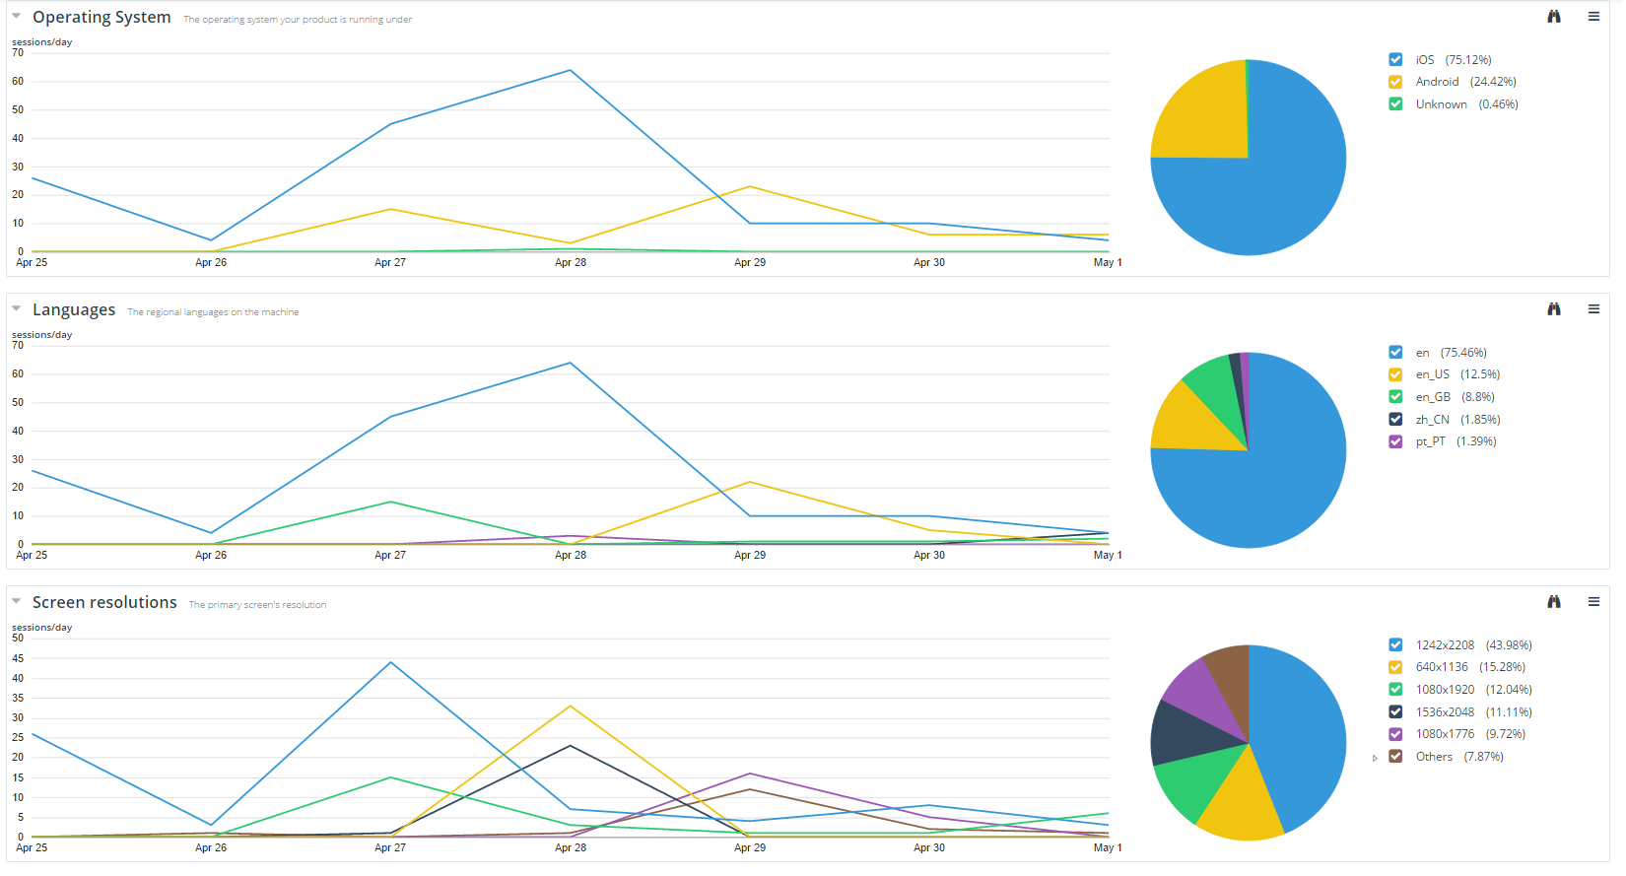

Slide 34
Track Feature Usage: Magic
function saveLocally() {
//saveLocally code here
monitor.trackFeature('CreateMeme.SaveLocally');
}
function share() {
//saveLocally code here
monitor.trackFeature('CreateMeme.Share');
}

Slide 35
Track Feature Usage: Magic
function saveLocally() {
//saveLocally code here
monitor.trackFeature('CreateMeme.SaveLocally');
}
function share() {
//saveLocally code here
monitor.trackFeature('CreateMeme.Share');
}
Your own namespace

Slide 36


Slide 37
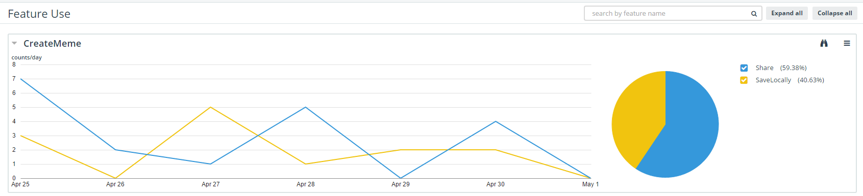
Track Feature Usage: Science

Slide 38
Track Values: Magic
function loadMemes() {
localStorage.getMyMemes()
.then(function (entities) {
monitor.trackFeatureValue("Templates.getMyMemes", entities.length);
//Do the rest here
}
}

Slide 39
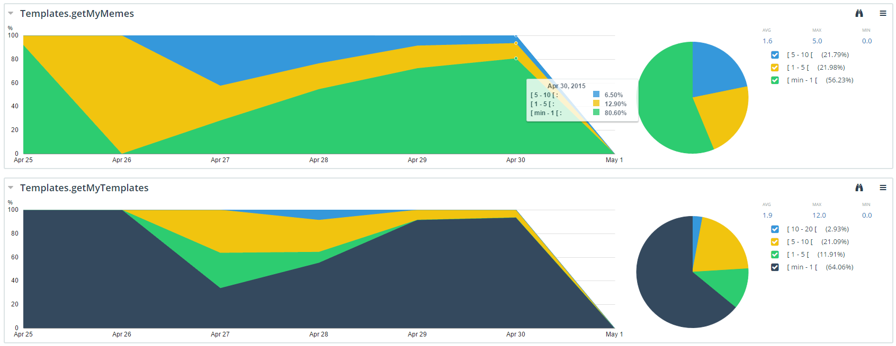
Track Values: Science

Slide 40
Track Performance: Magic
function getTemplates() {
monitor.trackFeatureStart('Templates.GetFromEverlive');
loadTemplates()
.then( function() {
//When Finished
monitor.trackFeatureStop('Templates.GetFromEverlive');
}
}

Slide 41
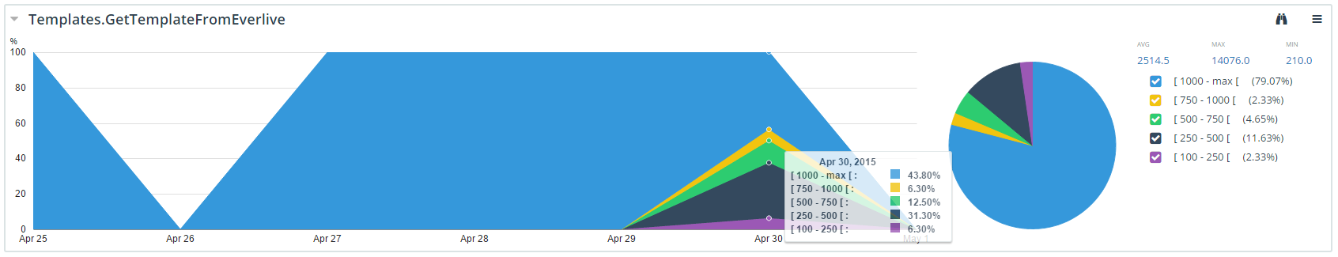
Track Performance : Science

Slide 42
Track Exceptions: Magic
try {
doSomething();
}
catch(exception) {
monitor.trackException(exception, 'error message');
}

Slide 43


Slide 44
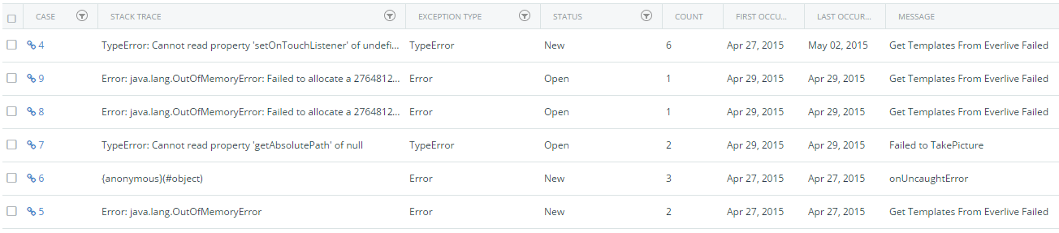
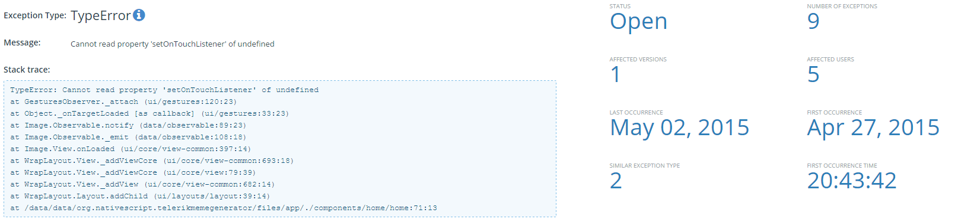
Track Exceptions: Science

Slide 45
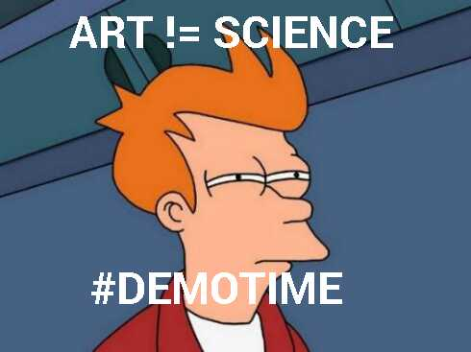
The Art of Science

Slide 46
Questions?
?

Slide 47
Questions?
?
Thank you!

